Slide 1
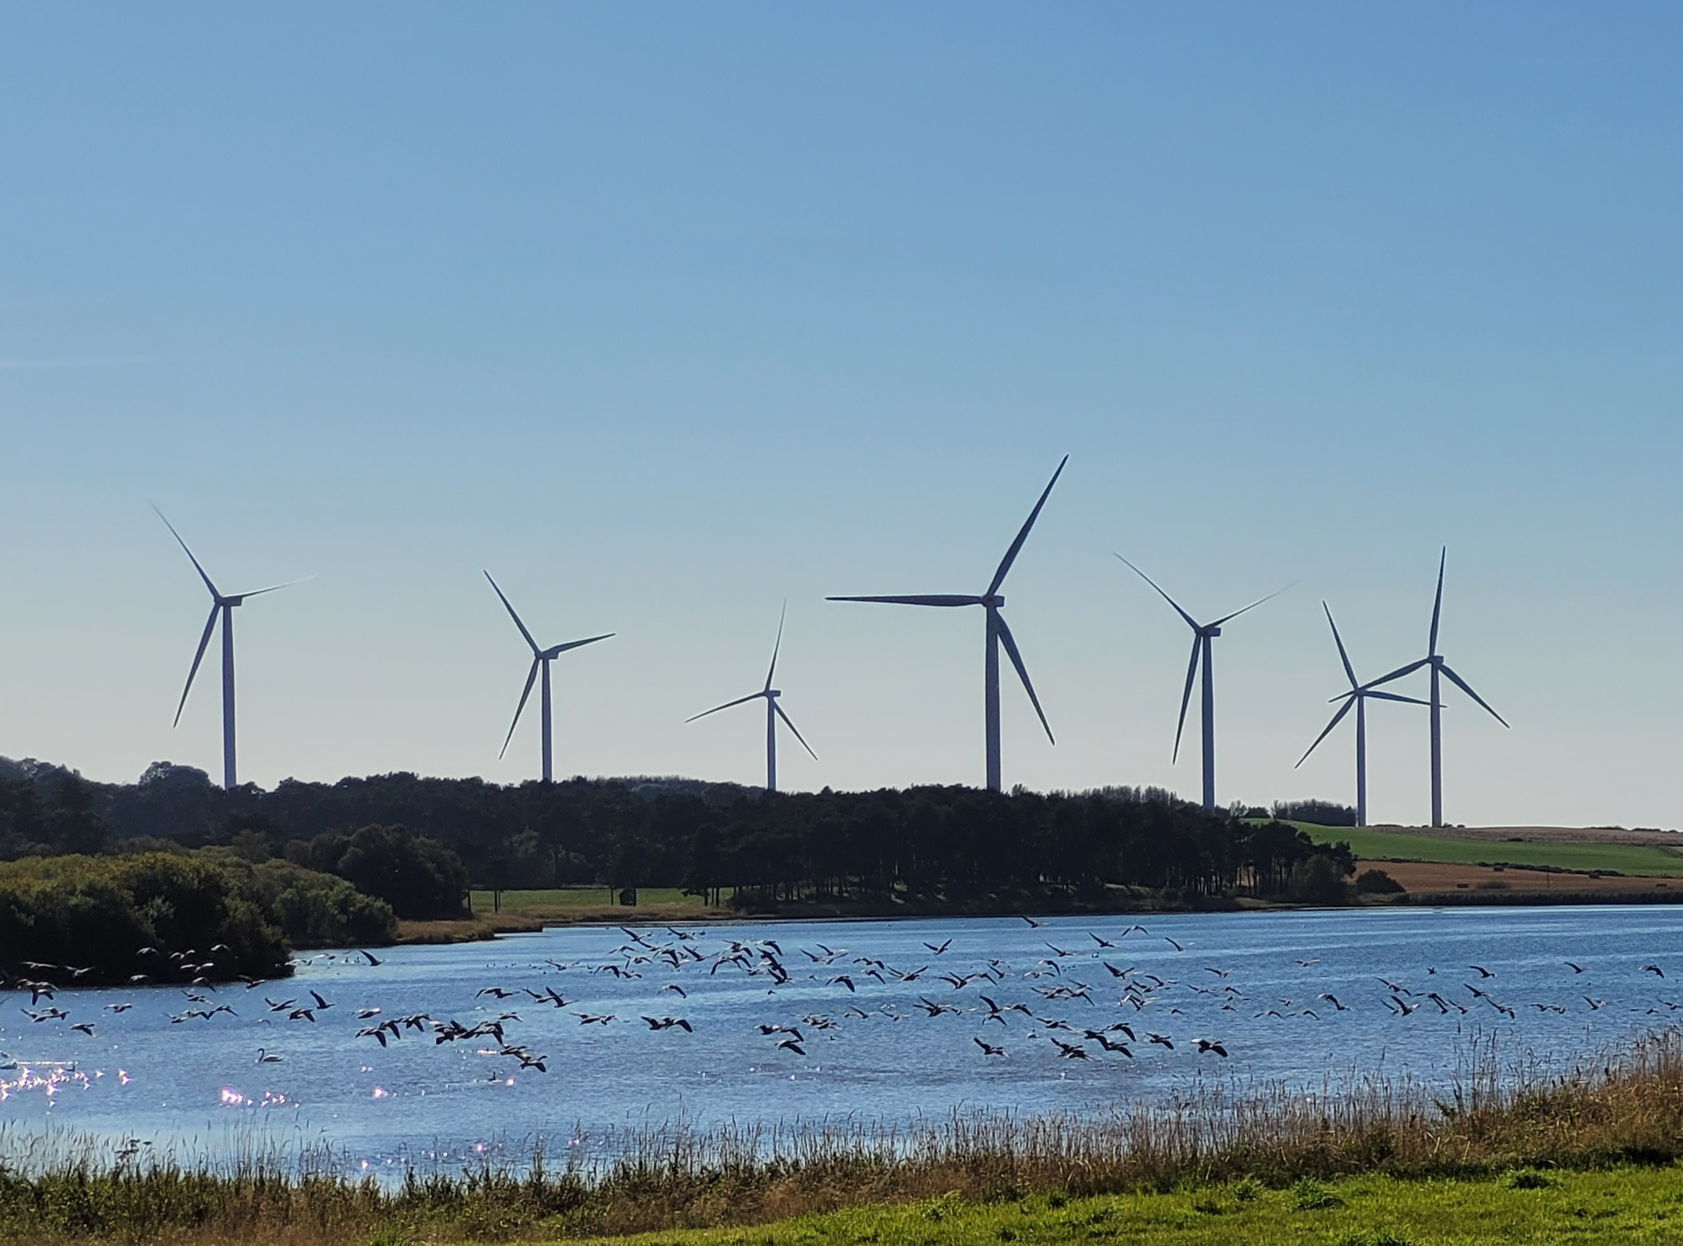


Annual Report 2024-25

Slide 2
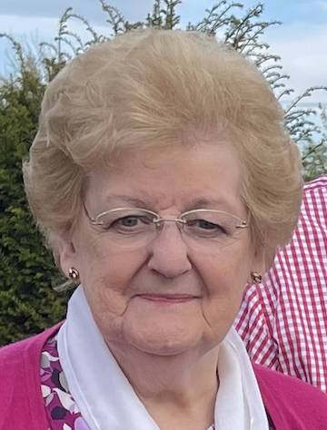
TRUSTEES REPORT
By Chairperson, Eleanor Martin
Welcome everyone to our Annual General Meeting of 4 Winds Trust. In the past year the charity has grown and developed with the wisdom and experience of new and experienced members from each of the four communities we serve. At this time we thank previous members who stood down for their support and enthusiasm which was imperative for the group success.
We would like to welcome new trustees who have become board members, they are doing marvelous work to ensure 4 Winds Trust funding reaches groups in the areas and hope they are enjoying the work and find it rewarding.
The Charity has been developing on a number of fronts in the past year. Some of the highlights are the continuing agreement with 4 Winds operator RES to ensure our communities are guaranteed funding into the future, improving our public profile to display the news and the impact of our work on our website. Keeping records updated gives a clear picture of the 4 Winds Trust impact over the past 11 years. The grant cheque presentation events organized by 4 Winds have been a positive move forward and I as chairperson have enjoyed meeting people and discussing their projects.
We continue to monitor the impact of grant funding in the communities and we thank you for all your cards, photographs and updates about your projects.
During this year we have also received additional training which has enabled trustees to be upskilled ensuring procedures are being followed and monitored. I would like to thank Fife Voluntary Action and in particular David McGrath who was absolutely fantastic in guiding us through OSCR regulation and new charity laws. We are, along with Fife Voluntary Action in the process of creating a new application form for anyone wishing to apply to be a trustee in the future.
I have every confidence that the charity will continue to deliver vital funding for the people of Auchtertool, Cowdenbeath, Lochgelly and Lumphinnans.
Thank you to the Trustees for their ongoing support and our funders RES.
I firmly believe we are now in the best shape ever for the challenges the new financial year brings. The total amount of funding recipients received this year was £ 83,341.55
Page 2

Slide 3
GOVERNANCE
4 Winds is established to distribute funding from the Little Raith Wind Farm, on behalf of the wind farm operator, RES. Our charity number is SC043913 and we are regulated by the Office of the Scottish Charity Regulator (OSCR).
4 Winds is a ‘2-tier’ SCIO, meaning we have trustees and members. The board of trustees manage the strategy, policy and day-to-day operations of the charity. The membership comprises all community councillors in Auchtertool, Cowdenbeath, Lochgelly and Lumphinnans.
We are grateful for the support of each of the four community councils in our area who send two representatives to sit on our board as trustees.
We also appreciate the input and efforts of our co-opted trustees, who provide additional community oversight on the board and, as per our constitution, stand down at each AMM.
For the year ended 30th April 2025, the following trustees have been part of 4 Winds:
Eleanor Martin, Lumphinnans CC – Acting Chairperson
Andy Bolden, Lumphinnans CC – Treasurer
Debbie Scollay, Auchtertool CC – Secretary (joined Dec 2023)
Joolie Martin, Cowdenbeath CC – joined May 2024
Wilma Aitchinson, Cowdenbeath CC – joined October 2024
Garrie Roberts, Lochgelly CC – joined Dec 2023
Andrea Cail, Auchtertool CC – joined Dec 2023
James Mann, Lochgelly CC – joined October 2024
Stuart Duffy, Cowdenbeath CC – left August 2024
Jim Martin, Lumphinnans CC – left October 2024
Mari Erskine, Lochgelly CC – left October 2024
Page 3

Slide 4
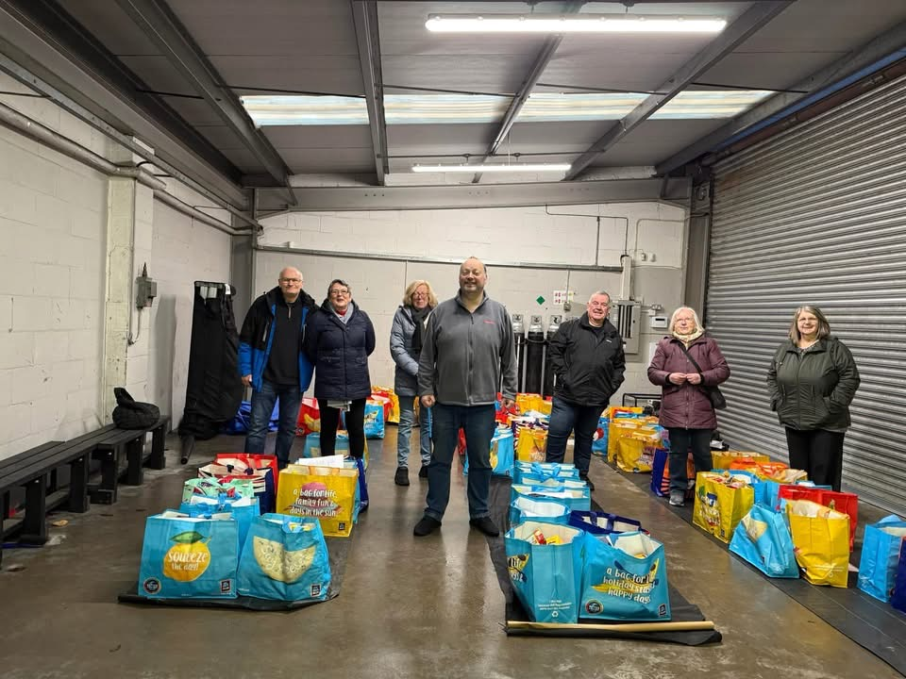
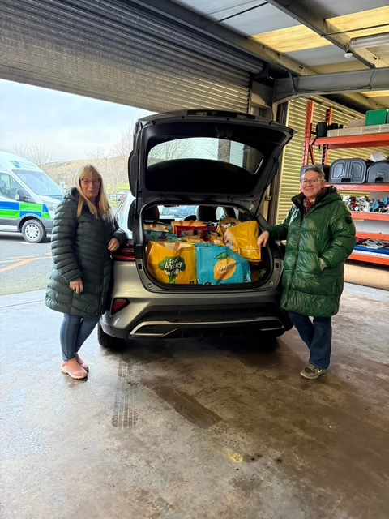
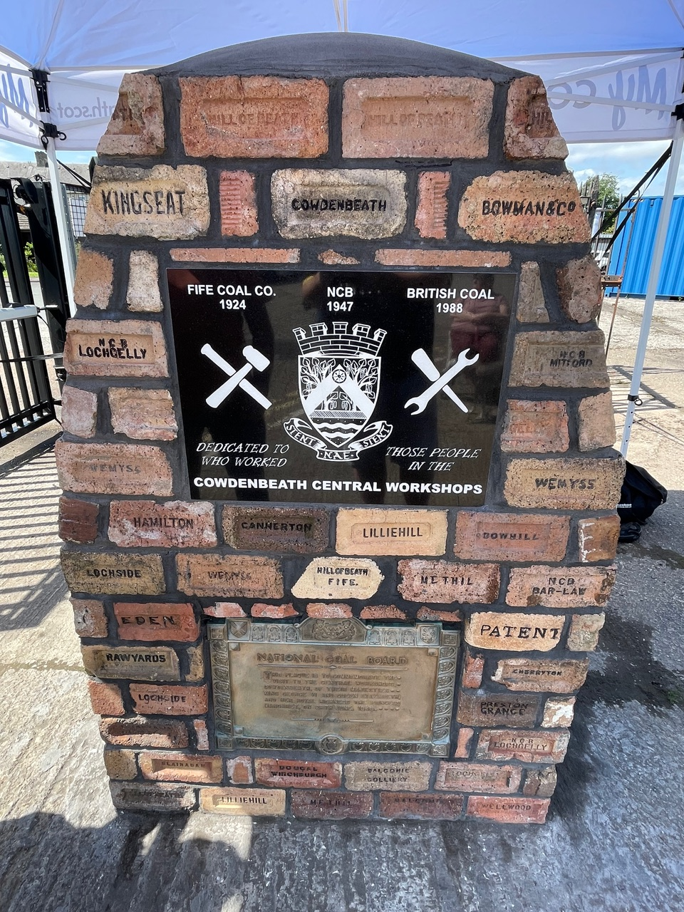
IMPACT
Feedback from funded groups
On behalf of the committee members of Acorn Aid, we thank you most sincerely for donating towards our Family Christmas hampers.
Your generosity has overwhelmed us and we can assure you that your donations will go a long way to supporting those in need in our community.
Thank you June and Brian Miller
NCB Workshops Cairn project
Your funding was essential in making this project a reality. The funding was used in the provision of materials and a new stone plaque for the cairn, which we are sincerely grateful for.
The cairn celebrates the achievement and contribution of the workers of Cowdenbeath Central Workshop, which built and maintained vital mining equipment for pits across Scotland and North England.
Page 4

Slide 5
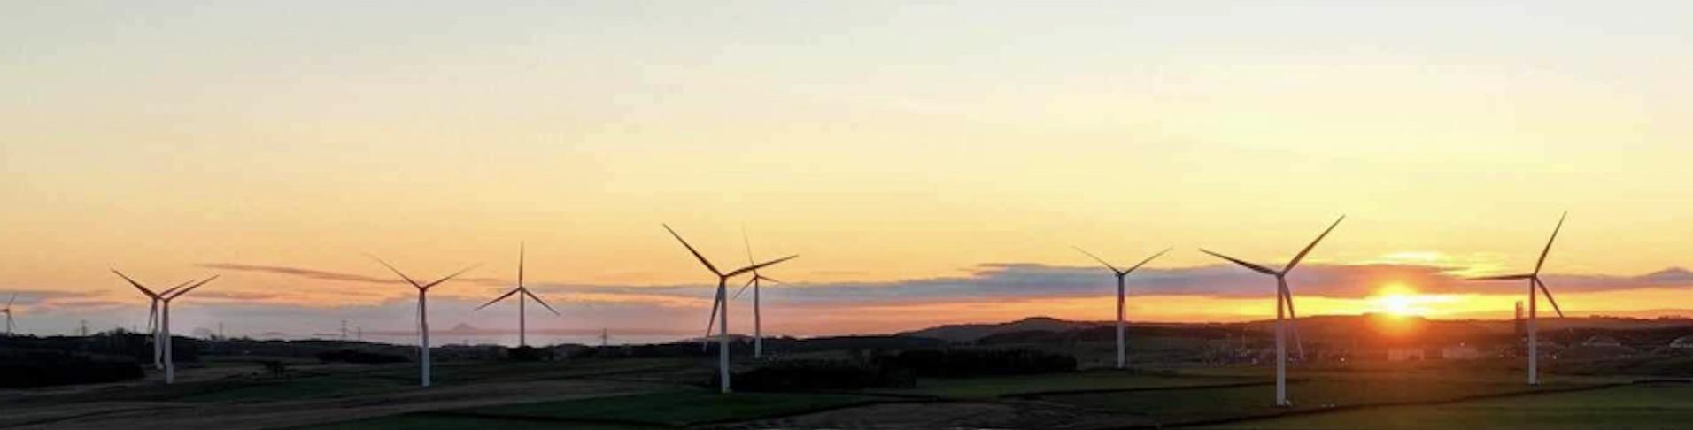
FUTURE PLANS
A new decade for 4 Winds
As the charity enters another year, we are filled with confidence about the future and the positive impact the funding from Little Raith Wind Farm is having on our communities.
With amendments to the Scottish charities regulations we have been working hard reviewing our governance and will continue to work with professional organizations to ensure compliance.
To assist prospective trustees we are in the process of designing a Recruitment Pack which will provide information on our Charity, Roles and processes.
Our governance and performance as a charity continues to be strong, with transparency and accountability for the communities we serve. We continue to review and develop a robust funding framework, ensuring the fund continues to support the work so vital in our local towns and villages.
Ensuring the fund is as accessible and available as possible to local groups continues to be our aim, we are committed to reviewing and learning, ensuring we have the right tools and processes in place. This will enable us to continue supporting the many local groups who support our local communities living in Auchtertool, Cowdenbeath, Lochgelly and Lumphinnans.
Registered Office:
c/o Maxwell Centre
Stenhouse Street
Cowdenbeath
Fife
KY4 9DD
Get in touch:
www.4winds.scot
admin@4winds.scot
Page 5

Slide 6
FUNDING SUMMARY
For the wind farm lifetime (May ‘13 to April ’25)
£817417
ISSUED IN GRANTS
SINCE LAUNCH
Auchtertool
Total
£67,961
Lochgelly
Total
£366,030
Cowdenbeath
Total
£263,211
Lumphinnans
Total
£120,215
Page 6

Slide 7
FUNDING SUMMARY
For the year ended 30th April 2025
35 GROUPS RECEIVED FUNDING
£83,341
ISSUED IN GRANTS
AVERAGE
GRANT
£2,381
Cowdenbeath
£26370.55
Lochgelly
£27,186.00
Auchtertool
£17,285.00
Lumphinnans
£12,500.00
Communities share of funding for the year 2024-25
Page 7

Slide 8
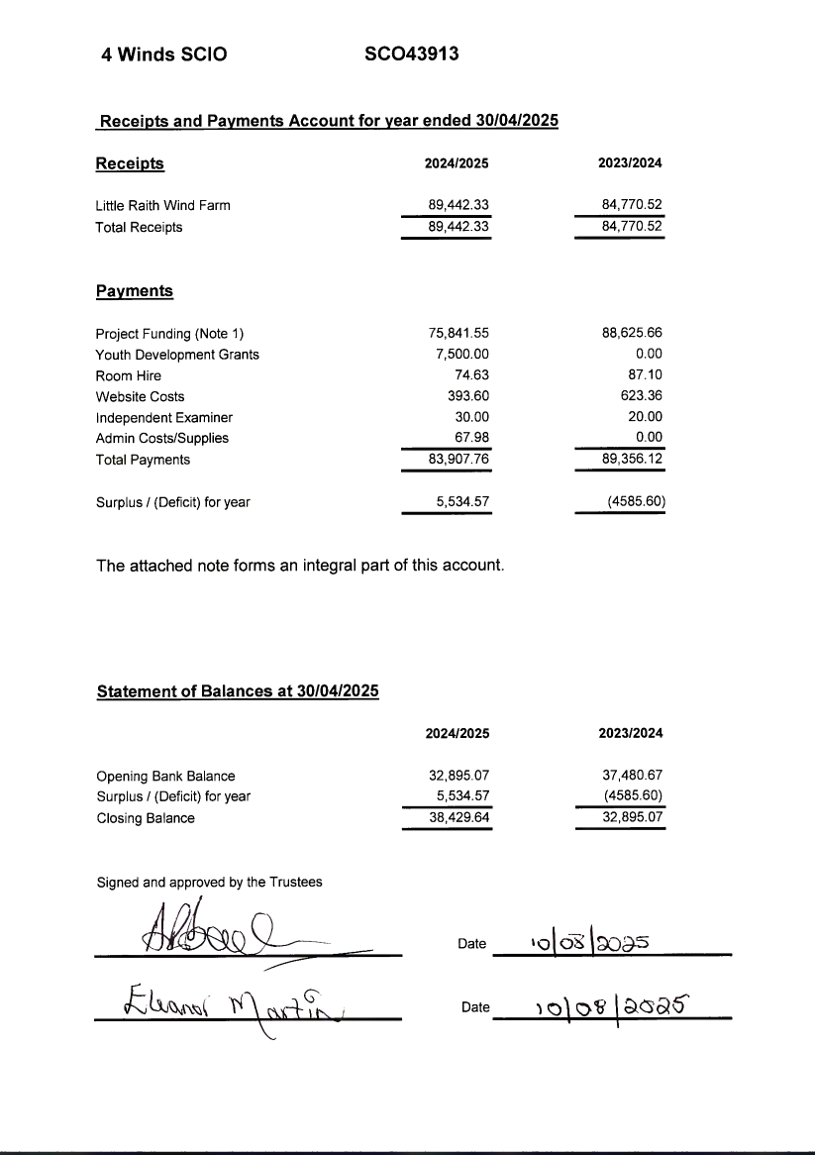
FINANCIAL SUMMARY
Page 8

Slide 9

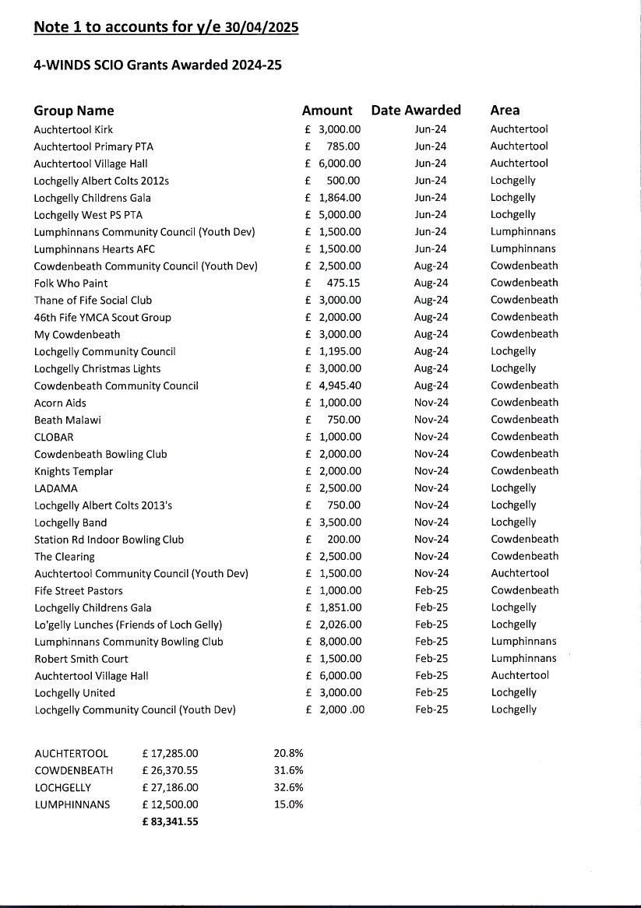
FUNDING AWARDS
Page 9

Slide 10

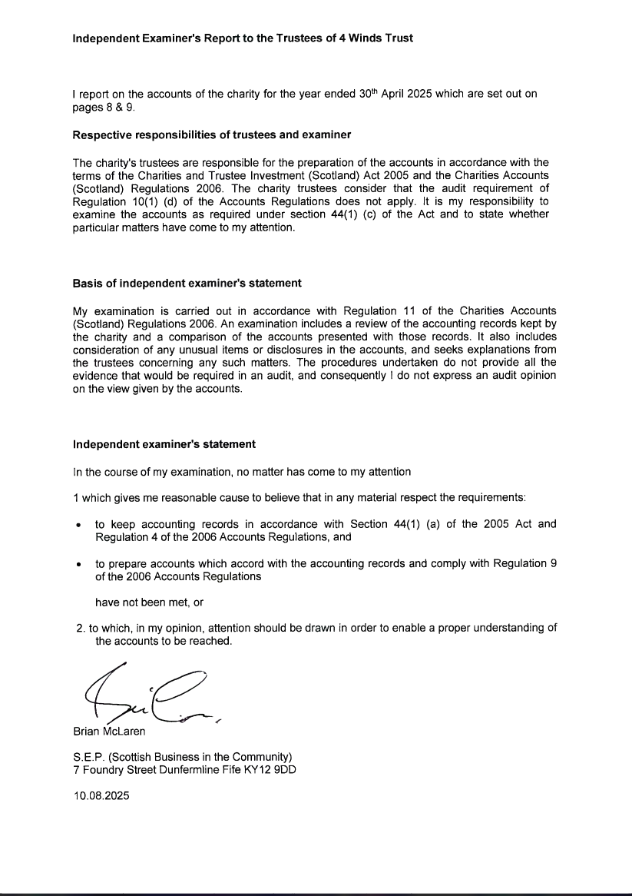
Page 10

